Slide 1
CS 478 – Tools for Machine Learning and Data Mining
SVM

Slide 2
Maximal-Margin Classification (I)
Consider a 2-class problem in R^{d}
As needed (and without loss of generality), relabel the classes to -1 and +1
Suppose we have a separating hyperplane
  Its equation is: w.x + b = 0
    w is normal to the hyperplane
    |b|/||w|| is the perpendicular distance from the hyperplane to the origin
    ||w|| is the Euclidean norm of w

Slide 3
Maximal-Margin Classification (II)
We can certainly choose w and b in such a way that:
  w.x_{i} + b > 0 when y_{i} = +1
  w.x_{i} + b < 0 when y_{i} = -1
Rescaling w and b so that the closest points to the hyperplane satisfy |w.x_{i} + b| = 1 , we can rewrite the above to
  w.x_{i} + b ≥ +1 when y_{i} = +1 (1)
  w.x_{i} + b ≤ -1 when y_{i} = -1 (2)

Slide 4
Maximal-Margin Classification (III)
Consider the case when (1) is an equality
  w.x_{i} + b = +1 (H+)
    Normal w
    Distance from origin |1-b|/||w||
Similarly for (2)
  w.x_{i} + b = -1 (H-)
    Normal w
    Distance from origin |-1-b|/||w||
We now have two hyperplanes (// to original)

Slide 5
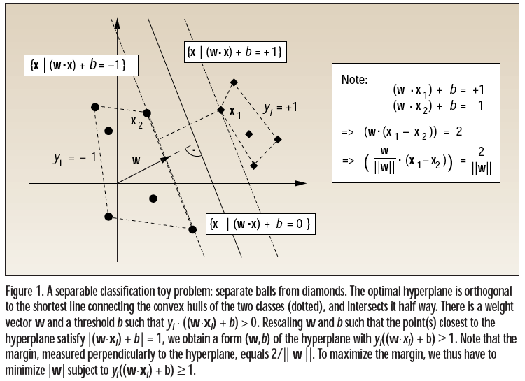
Maximal-Margin Classification (IV)

Slide 6
Maximal-Margin Classification (V)
Note that the points on H- and H+ are sufficient to define H- and H+ and therefore are sufficient to build a linear classifier
Define the margin as the distance between H- and H+
What would be a good choice for w and b?
  Maximize the margin

Slide 7
Maximal-Margin Classification (VI)
From the equations of H- and H+, we have
  Margin = |1-b|/||w|| - |-1-b|/||w||
  = 2/||w||
So, we can maximize the margin by:
  Minimizing ||w||²
  Subject to: y_{i}(w.x_{i} + b) - 1 ≥ 0 (see (1) and (2) above)

Slide 8
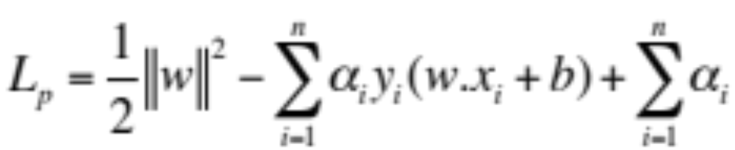
Minimizing ||w||²
Use Lagrange multipliers for each constraint (1 per training instance)
  For constraints of the form c_{i} ≥ 0 (see above)
    The constraint equations are multiplied by positive Lagrange multipliers, and
    Subtracted from the objective function
Hence, we have the Lagrangian

Slide 9
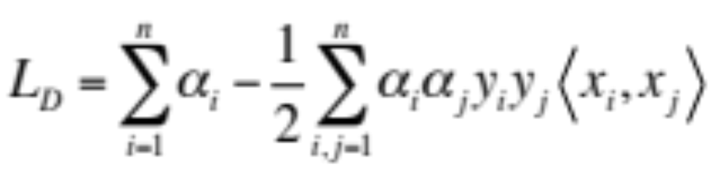
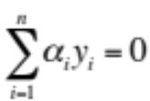
Maximizing L_{D}
It turns out, after some transformations beyond the scope of our discussion that minimizing L_{P} is equivalent to maximizing the following dual Lagrangian:
  Where <x_{i},x_{j}> denotes the dot product
subject to:

Slide 10
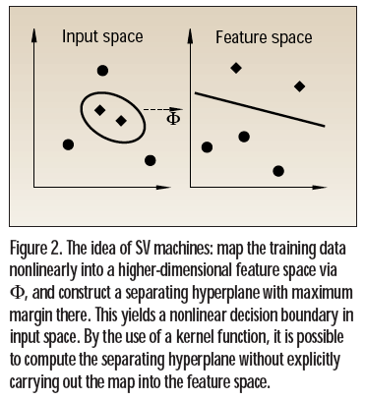
SVM Learning (I)
We could stop here and we would have a nice linear classification algorithm.
SVM goes one step further:
  It assumes that non-linearly separable problems in low dimensions may become linearly separable in higher dimensions (e.g., XOR)

Slide 11
SVM Learning (II)
SVM thus:
  Creates a non-linear mapping from the low dimensional space to a higher dimensional space
  Uses MM learning in the new space
Computation is efficient when “good” transformations are selected
  The kernel trick

Slide 12
Choosing a Transformation (I)
Recall the formula for L_{D}
Note that it involves a dot product
  Expensive to compute in high dimensions
What if we did not have to?

Slide 13
Choosing a Transformation (II)
It turns out that it is possible to design transformations φ such that:
  <φ(x), φ(y)> can be expressed in terms of <x,y>
Hence, one needs only compute in the original lower dimensional space
Example:
  φ: R²➔R³ where φ(x)=(x₁², √2x₁x_{2,} x₂²)

Slide 14



Choosing a Kernel
Can start from a desired feature space and try to construct kernel
More often one starts from a reasonable kernel and may not analyze the feature space
Some kernels are better fit for certain problems, domain knowledge can be helpful
Common kernels:
  Polynomial
  Gaussian
  Sigmoidal
  Application specific

Slide 15
SVM Notes
Excellent empirical and theoretical potential
Multi-class problems not handled naturally
How to choose kernel – main learning parameter
  Also includes other parameters to be defined (degree of polynomials, variance of Gaussians, etc.)
Speed and size: both training and testing, how to handle very large training sets not yet solved
MM can lead to overfit due to noise, or problem may not be linearly separable within a reasonable feature space
  Soft Margin is a common solution, allows slack variables
  α_{i} constrained to be >= 0 and less than C. The C allows outliers. How to pick C?

